Slide 1

RUNGTA COLLEGE OF DENTAL SCIENCES & RESEARCH
TITLE OF THE TOPIC-
THEORIES OF GROWTH
DEPARTMENT OF ORTHODONTICS AND DENTOFACIAL ORTHOPAEDICS

Slide 2
Specific learning Objectives
CORE AREAS | DOMAIN | CATEGORY
INTRODUCTION | AFFECTIVE | DESIRE TO KNOW
GROWTH DEFINITIONS | COGNITIVE | NEED TO KNOW
MAJOR THEORIES OF GROWTH | COGNITIVE | MUST KNOW
FMH IN DETAIL | COGNITIVE | MUST KNOW

Slide 3
CONTENTS :
PART I
Introduction
Growth: Some definitions
Major theories of growth
    Bone remodeling theory
    The genetic theory
    The sutural hypothesis
    Nasal septum theory
  PART II
    Functional matrix hypothesis In detail
    Growth relativity hypothesis
Conclusion
References

Slide 4
Functional Matrix Hypothesis
(Moss’ Hypothesis) /(FMH)
The concept of this theory was introduced first by Vander Klaaw (1948- 52).
Melvin L. Moss developed the form and function concept into the functional matrix hypothesis.(1960s).

Slide 5
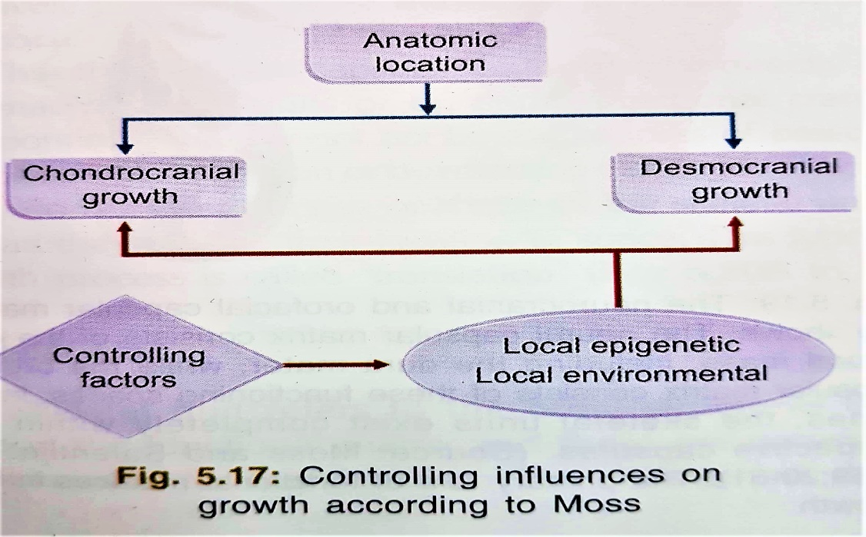
Essence of the theory:
Functional matrix hypothesis maintains that apart from initiating the process of development, heredity and genes play no active role in growth of skeletal structures in general and craniofacial skeleton in particular.
The craniofacial skeleton develops initially, and later grows in direct response to the extrinsic epigenetic environment.
Notes:
Epigenetic: indirect genetic control whatever its source may be

Slide 6
Definition
The origin, growth and maintenance of all the skeletal tissues and organs are always secondary, compensatory and obligatory responses to temporally and operationally prior events or processes that occur in specifically related non skeletal tissues, organs or functioning spaces.
Proponents of the functional matrix states that the expansion of the soft tissue matrix is primary and the bone growth is purely secondary and compensatory event.
Translation of the various bones of the face is due to volumetric expansion of the encapsulated spaces or tissues.

Slide 7
Explanation
To understand the factors that affect craniofacial bone growth, it is necessary to understand the local environment and resultant skeletal structure in terms of their functional cranial component.
Functional cranial component
The FMH considers the head, not the skull as the region of the body where a number of operations are carried out.
To perform each function, certain hard and soft tissues are required.
The totality of all the skeletal structures, soft tissues and functioning spaces(nasal, oral, etc.) necessary to carry out a specific function is collectively called a “functional cranial component”.

Slide 8
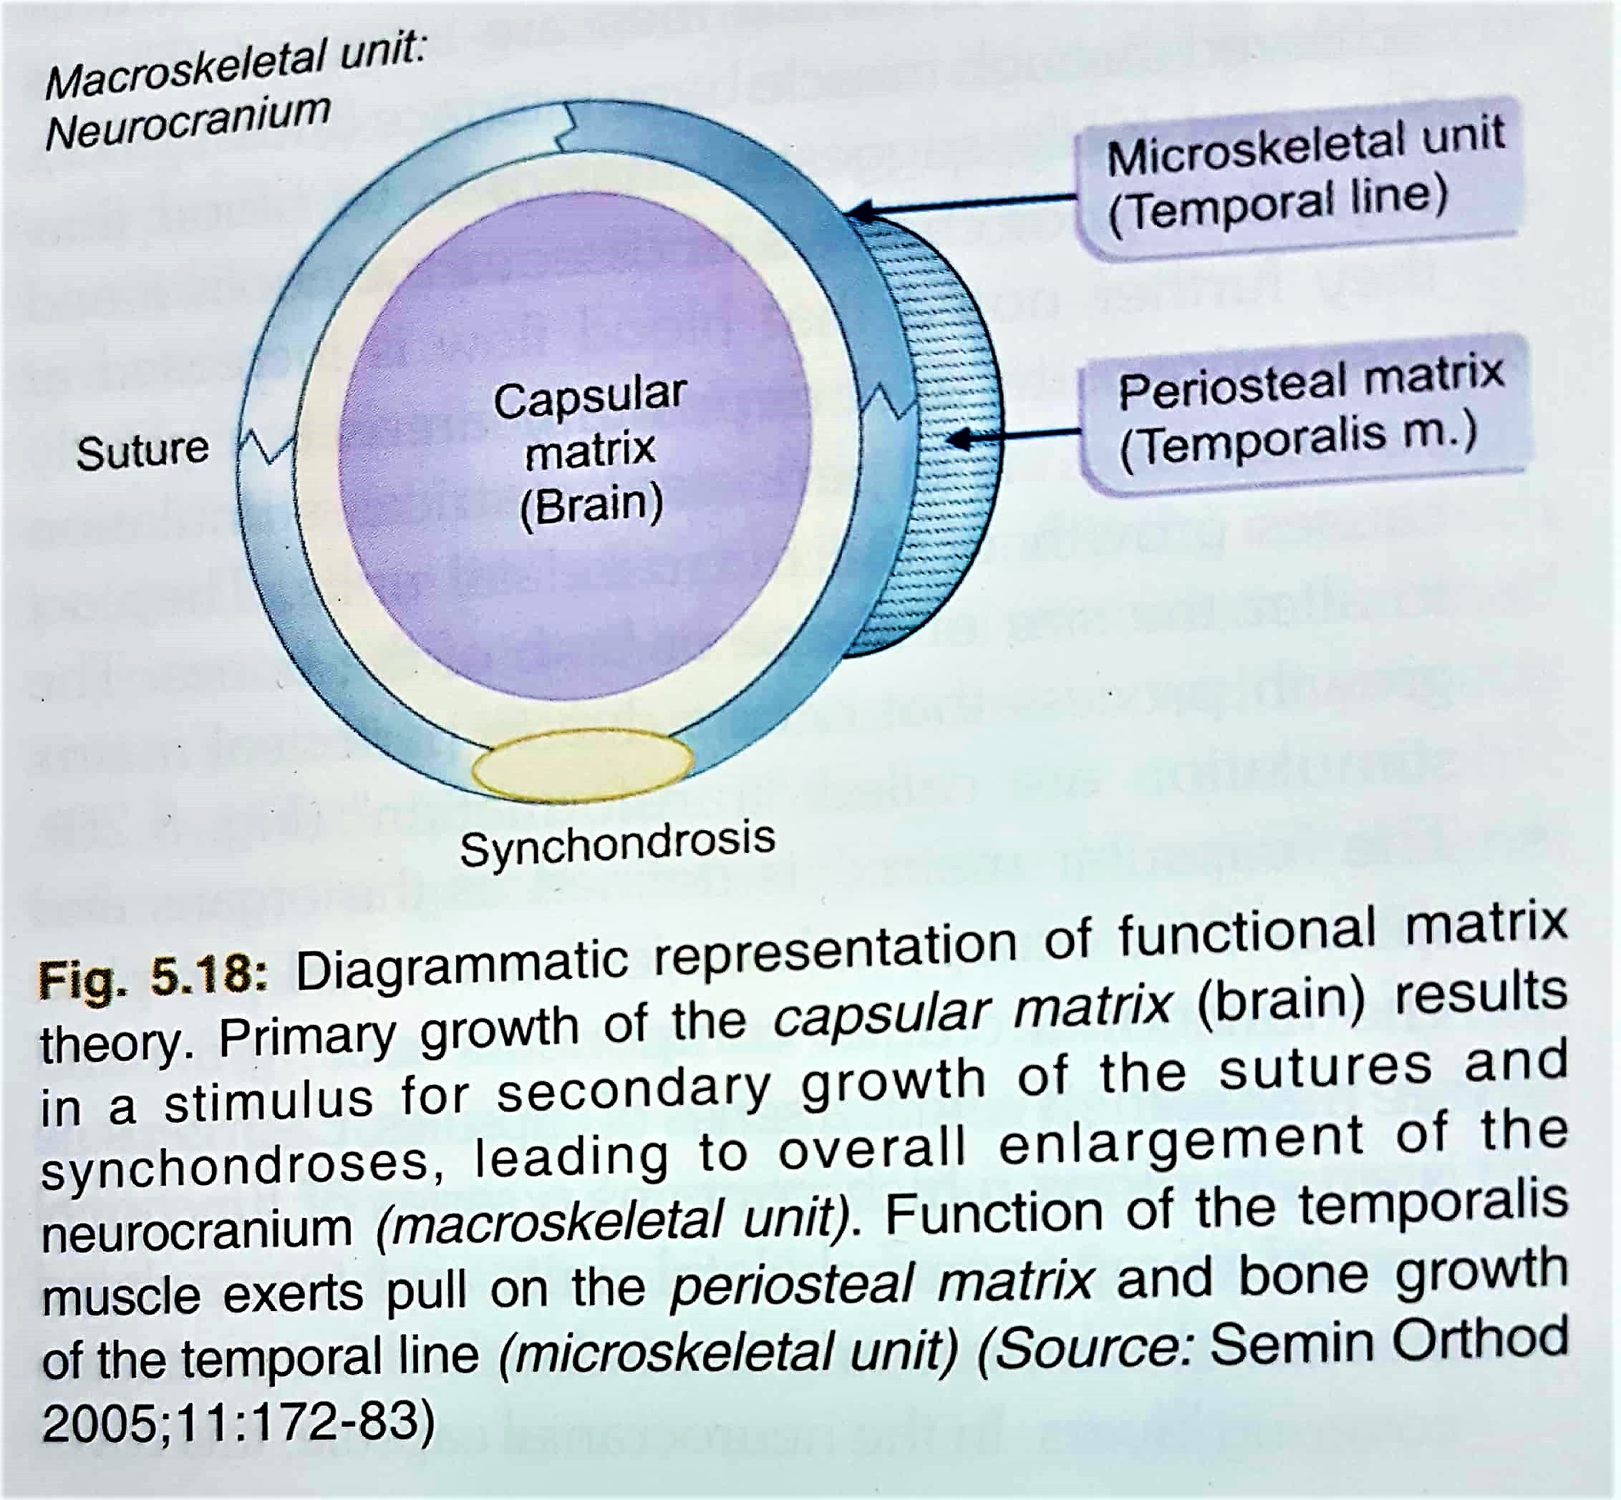

Slide 9

Functional Cranial Component (one function)
A related skeletal unit that acts biomechanically to protect and/or support its functional matrix
Skeletal cranial component
Tissues and spaces that completely perform a function
Functional matrix
Periosteal matrix
Capsular matrix

Slide 10
One function
Functional cranial component
Skeletal unit
Functional matrix
Micro skeletal
Macro skeletal
Periosteal matrix e.g.. muscles, blood vessels, nerves, teeth
Capsular matrix e.g.. Skin and duramater, skin and mucosa
Notes:
Any function is actually performed by the functional matrix, while the skeletal unit provides the protection and support.

Slide 11
Functional Matrix
The functional matrix refers to all the soft tissues and spaces that perform a given function.
Periosteal Matrix
  The periosteal matrix corresponds to the immediate local environment.
  These are those tissues that influence the bone directly through the periosteum
  Examples of periosteal matrices includes: Muscles, blood vessels and nerves lying in grooves or entering or exiting through foramina, teeth.

Slide 12
All the periosteal matrices act homogeneously by means of osseous deposition and resorption.
The muscles are attached either into the skeletal tissue or indirectly by fusion with the outer fibrous layer of periosteum
Functioning muscles influence developmental changes in the form of skeletal tissue to which they are attached
Lack of contraction of muscles leads to atrophy of the bone.

Slide 13
The periosteal matrices stimulation causes growth of the microskeletal units.
They act to alter the size or shape or both of the bones.
  Temporalis – coronoid process, temporal line
  Tooth - alveolar bone
The growth process that occurs due to periosteal matrix stimulation is called Transformation

Slide 14
Capsular matrix
Each capsule is an envelop which contains a series of functional cranial component, skeletal units and their related functional matrices and is surrounded by two covering layers.
Examples-
    Neurocranial capsule - scalp and duramater
    Orofacial capsule – the skin and mucosa
Capsules tend to influence macroskeletal units which means portions of several bones are simultaneously affected.

Slide 15
Neurocanial Capsule
The neurocranial capsular matrix consists :
Neurocranial capsular matrix
BRAIN
LEPTOMENINGES
CSF

Slide 16
The expansion of the enclosed and protected capsular matrix volume is the primary event in the expansion of the neurocranial capsule
As the capsule enlarges ,the whole of the included and enclosed functional components, that is the periosteal matrices and the microskeletal units are carried outward in a totally passive manner.

Slide 17
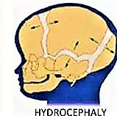
The calvarial functional cranial components as a whole are passively and secondarily translated in space.
The expansion of the neurocranial capsule is proportional to the increase in neural mass. This can be shown by considering hydrocephaly as an example.
This suggests that the neural skull does not grow first and thus provide space for the expansion of the neural mass rather the growth of neural mass is primary and causes secondary compensatory growth of the skull

Slide 18
Orofacial Capsular Matrix
The orofacial capsular matrix or oropharyngeal functioning spaces is surrounded by the orofacial capsule.
Limiting layer of this cavity are skin on the external aspect and mucous membrane internally.
These surround and protect the oropharyngeal functioning spaces, and the volumetric expansion of these spaces produces a compensatory increase in size of the orofacial capsule. .

Slide 19
As the capsule enlarges, both the periosteal matrices along with the respective skeletal units are passively and secondarily translated to a new position in space.
Thus the enclosed capsular matrices act indirectly on the macroskeletal unit or on entire functional cranial component.
They do not alter the shape or size of the skeletal unit, instead they change their location in space.
This type of growth process is called translation.

Slide 20
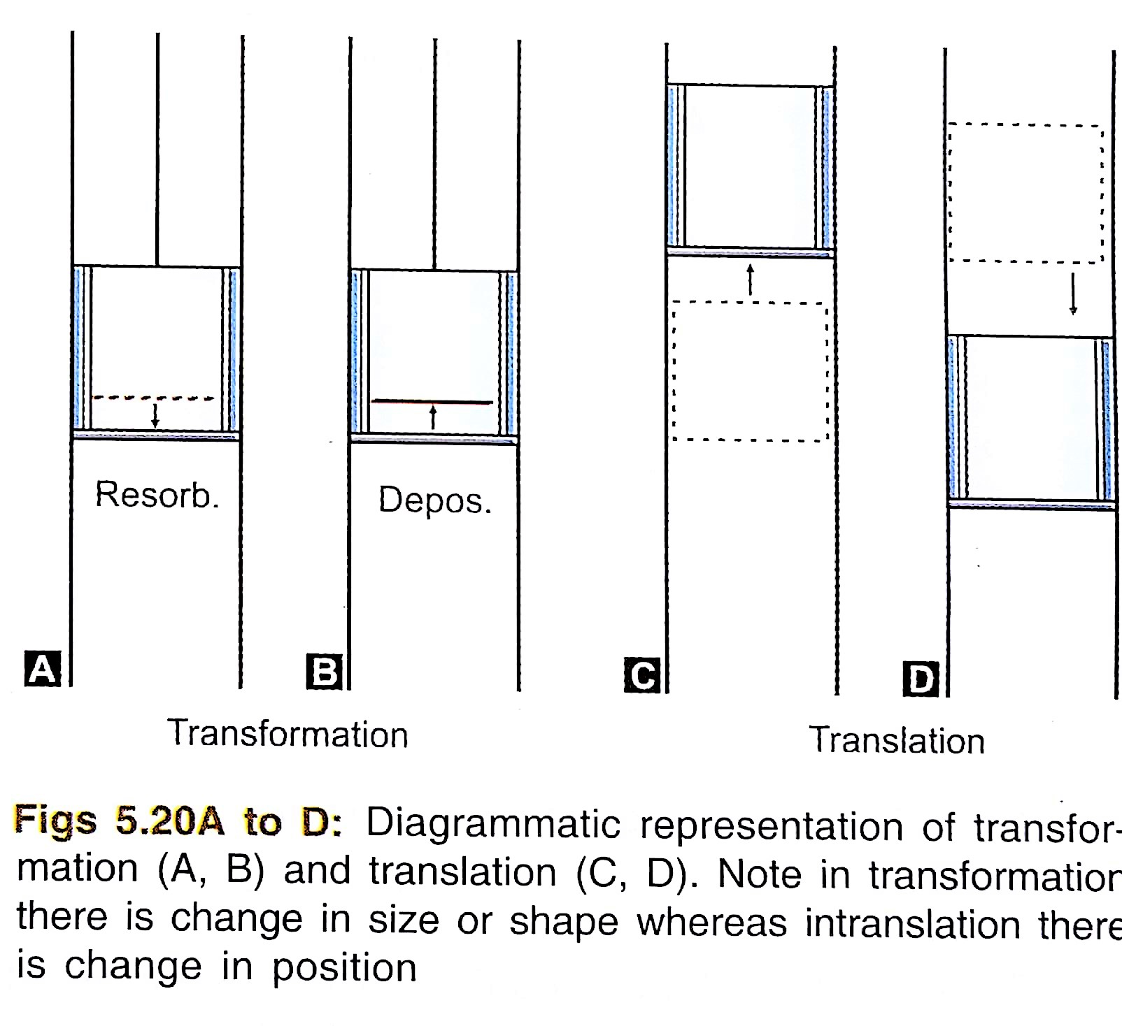

Slide 21
Skeletal Unit
The skeletal unit refers to the bony structures that support the functional matrix and these are necessary and permissive to that function.
Skeletal Unit
Microskeletal Unit
Macroskeletal Unit

Slide 22
Microskeletal units are parts of bone whose growth is modulated by the periosteal matrices.
Functional variations in the periosteal matrices may be expressed within the microskeletal units
The possible interaction between periosteal matrix and microskeletal units includes - temporalis-coronoid process, masseter, medial pterygoid – gonial angle, teeth-alveolar bone.

Slide 23
In the mandible we distinguish the following microskeletal units.
  Coronoid microskeletal unit – related to functional demands of temporalis muscle
  Alveolar unit – related to presence of teeth.
  Basal micro skeletal unit – related to inferior alveolar neurovascular bundle.

Slide 24
Macroskeletal units are made of core of :
MACROSKELETAL UNIT
MAXILLA
MANDIBLE
NEUROCRANIUM

Slide 25
Through the neurotrophic influence, the spatial constancy of the infra orbital canal with respect to anterior cranial base and mandibular canal from foramen ovale through mandibular foramen is maintained (UNLOADED NERVE CONCEPT).
Moss and Greenberg pointed out the basic maxillary unit is the core which supports and protects the infraorbital neurovascular triad, and in mandible, the basal tubular portion which protect the mandibular canal.

Slide 26
The capsular matrix expansion causes the macroskeletal unit to passively change the position. This process is called translation growth of skeletal structures.
The overall skeletal growth is a combination of changes in micoskeletal and macroskeletal units due to stimulation of periosteal and capsular matrices respectively.
This total growth change is termed interosseous growth by Moss.

Slide 27
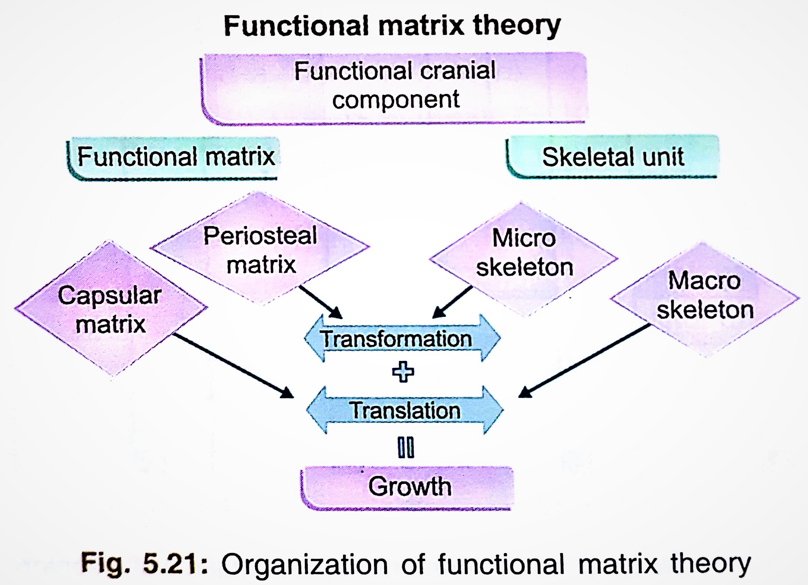

Slide 28
CRANIOFACIAL GROWTH
ACTIVE GROWTH PROCESS
SUTURAL GROWTH
BONE REMODELLING
PASSIVE GROWTH PROCESS
THE GROWTH OF NEURAL, ORBITAL, CSF, & OTHER MASSES & REAL SUBSTANCE
CEPHALIC CARTILAGE GROWTH
THE EXPANSION OF ORO-NASO-PHARYNGEAL AND OTHER FUNCTIONING SPACES

Slide 29
Use Of The “Functional Matrix” In The Therapy Of Orthodontics, Dentofacial Orthopedics, And Orthognathic And Craniofacial Surgery
1. Orthodontics
Periosteal Matrix ------------> Skeletal Unit
[Teeth] [Alveolar Bone]
2. Dentofacial Orthopedics and Orthognathic Surgery
Capsular Matrix ------------> Multiple Skeletal Units
[Functional Appliances] [Jaw Bones]
Capsular Matrix -------------> Multiple Skeletal Units
[Distraction osteogensis: [Jaw Bones]
e.g., hemifacial microsomia]

Slide 30
Growth Relativity Hypothesis :
( John C Voudouris 2000)
Growth relativity refers to the growth that is relative to its displaced condyles from actively relocating fossa.
John Voudouris introduced this concept to explain the possible effect of functional appliances on condyles and resulting growth.

Slide 31
The main foundation of growth relative hypothesis are :
Displacement of condyles
Nonmuscular viscoelastic tissue stretch
Force transduction & new bone formation.

Slide 32
Force Transduction And New Bone Formation :
  This is the most interesting aspect wherein new bone formation takes place at some distance from actual retrodiscal tissue attachments in the fossa.
Effect of three growth stimuli (displacement + viscoelasticity + transduction of force ) :
  Modification of growth “first” occurs as a result of the action of anterior mandibular displacement.
  “Second”, the condyle is affected by the posterior viscoelastc tissue anchored between the glenoid fossa.

Slide 33
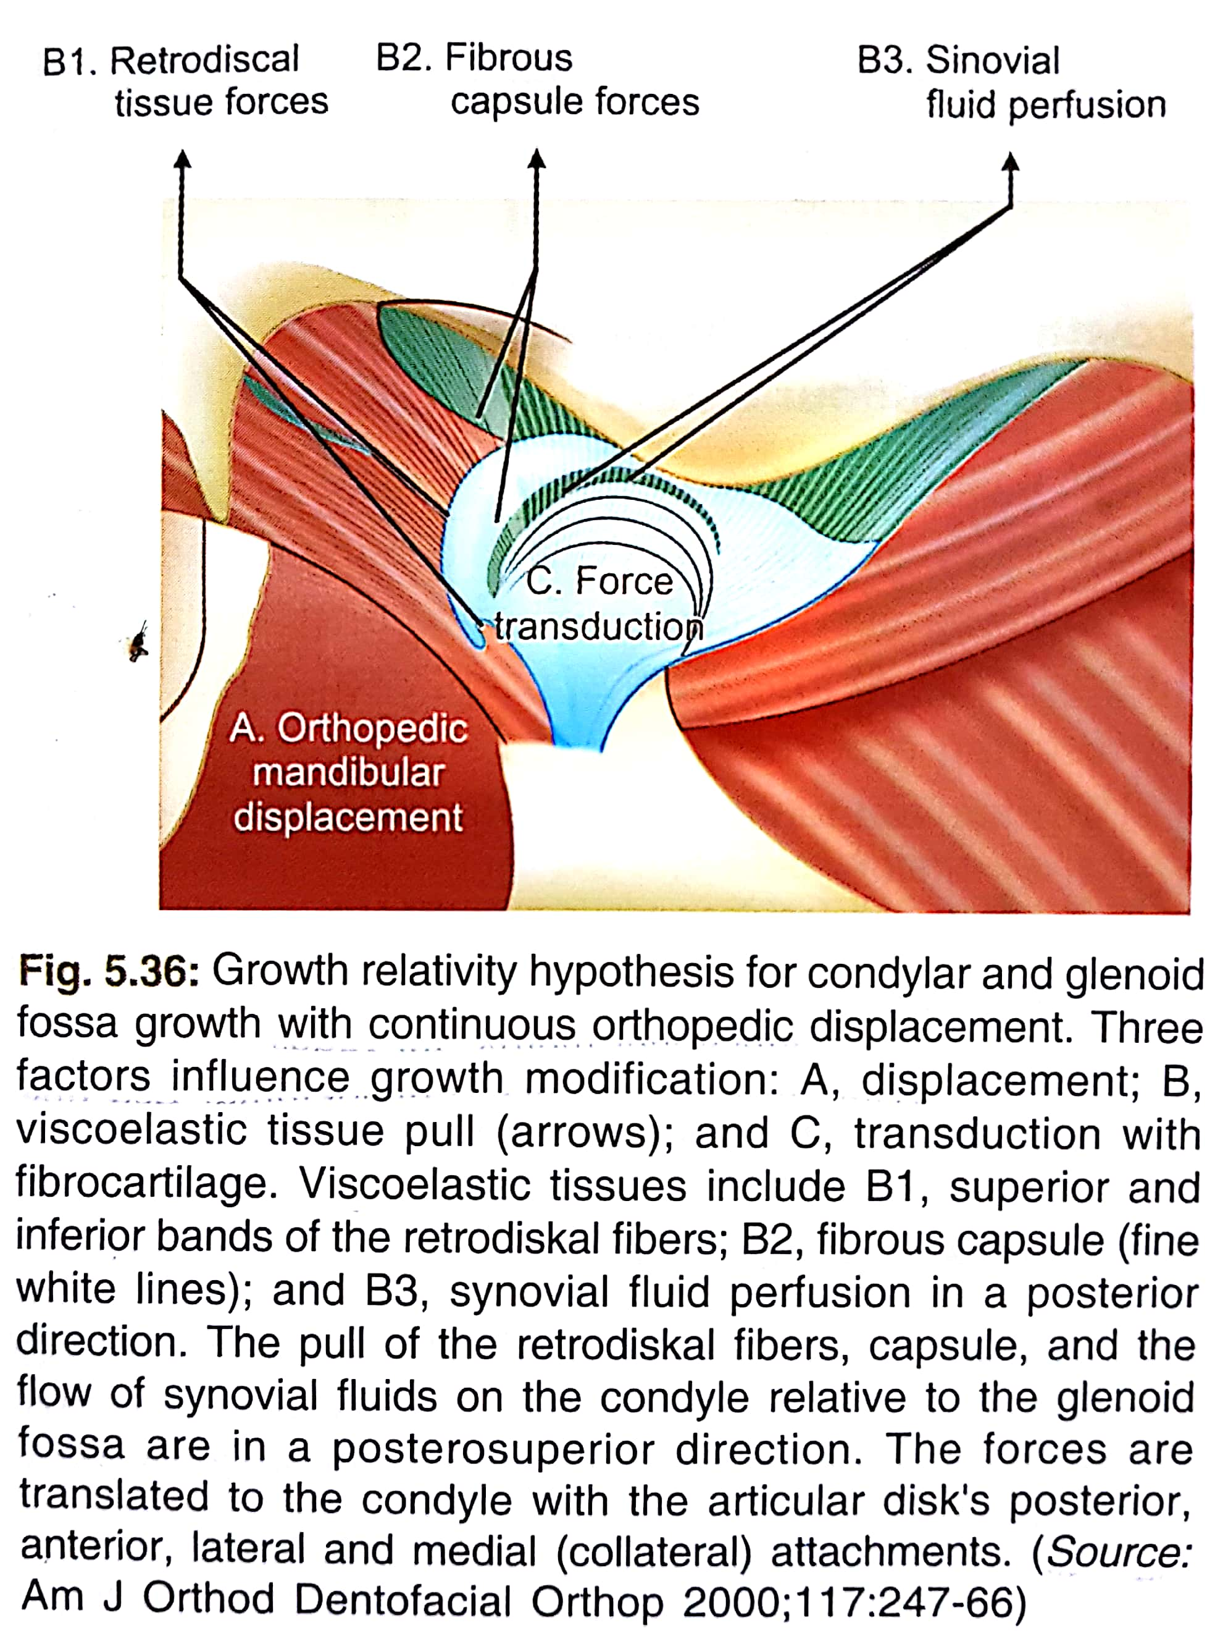
And “third”, displacement and viscoelasticity further stimulate the normal condylar growth by transduction of forces over the fibrocartilage cap of the condylar head.

Slide 34
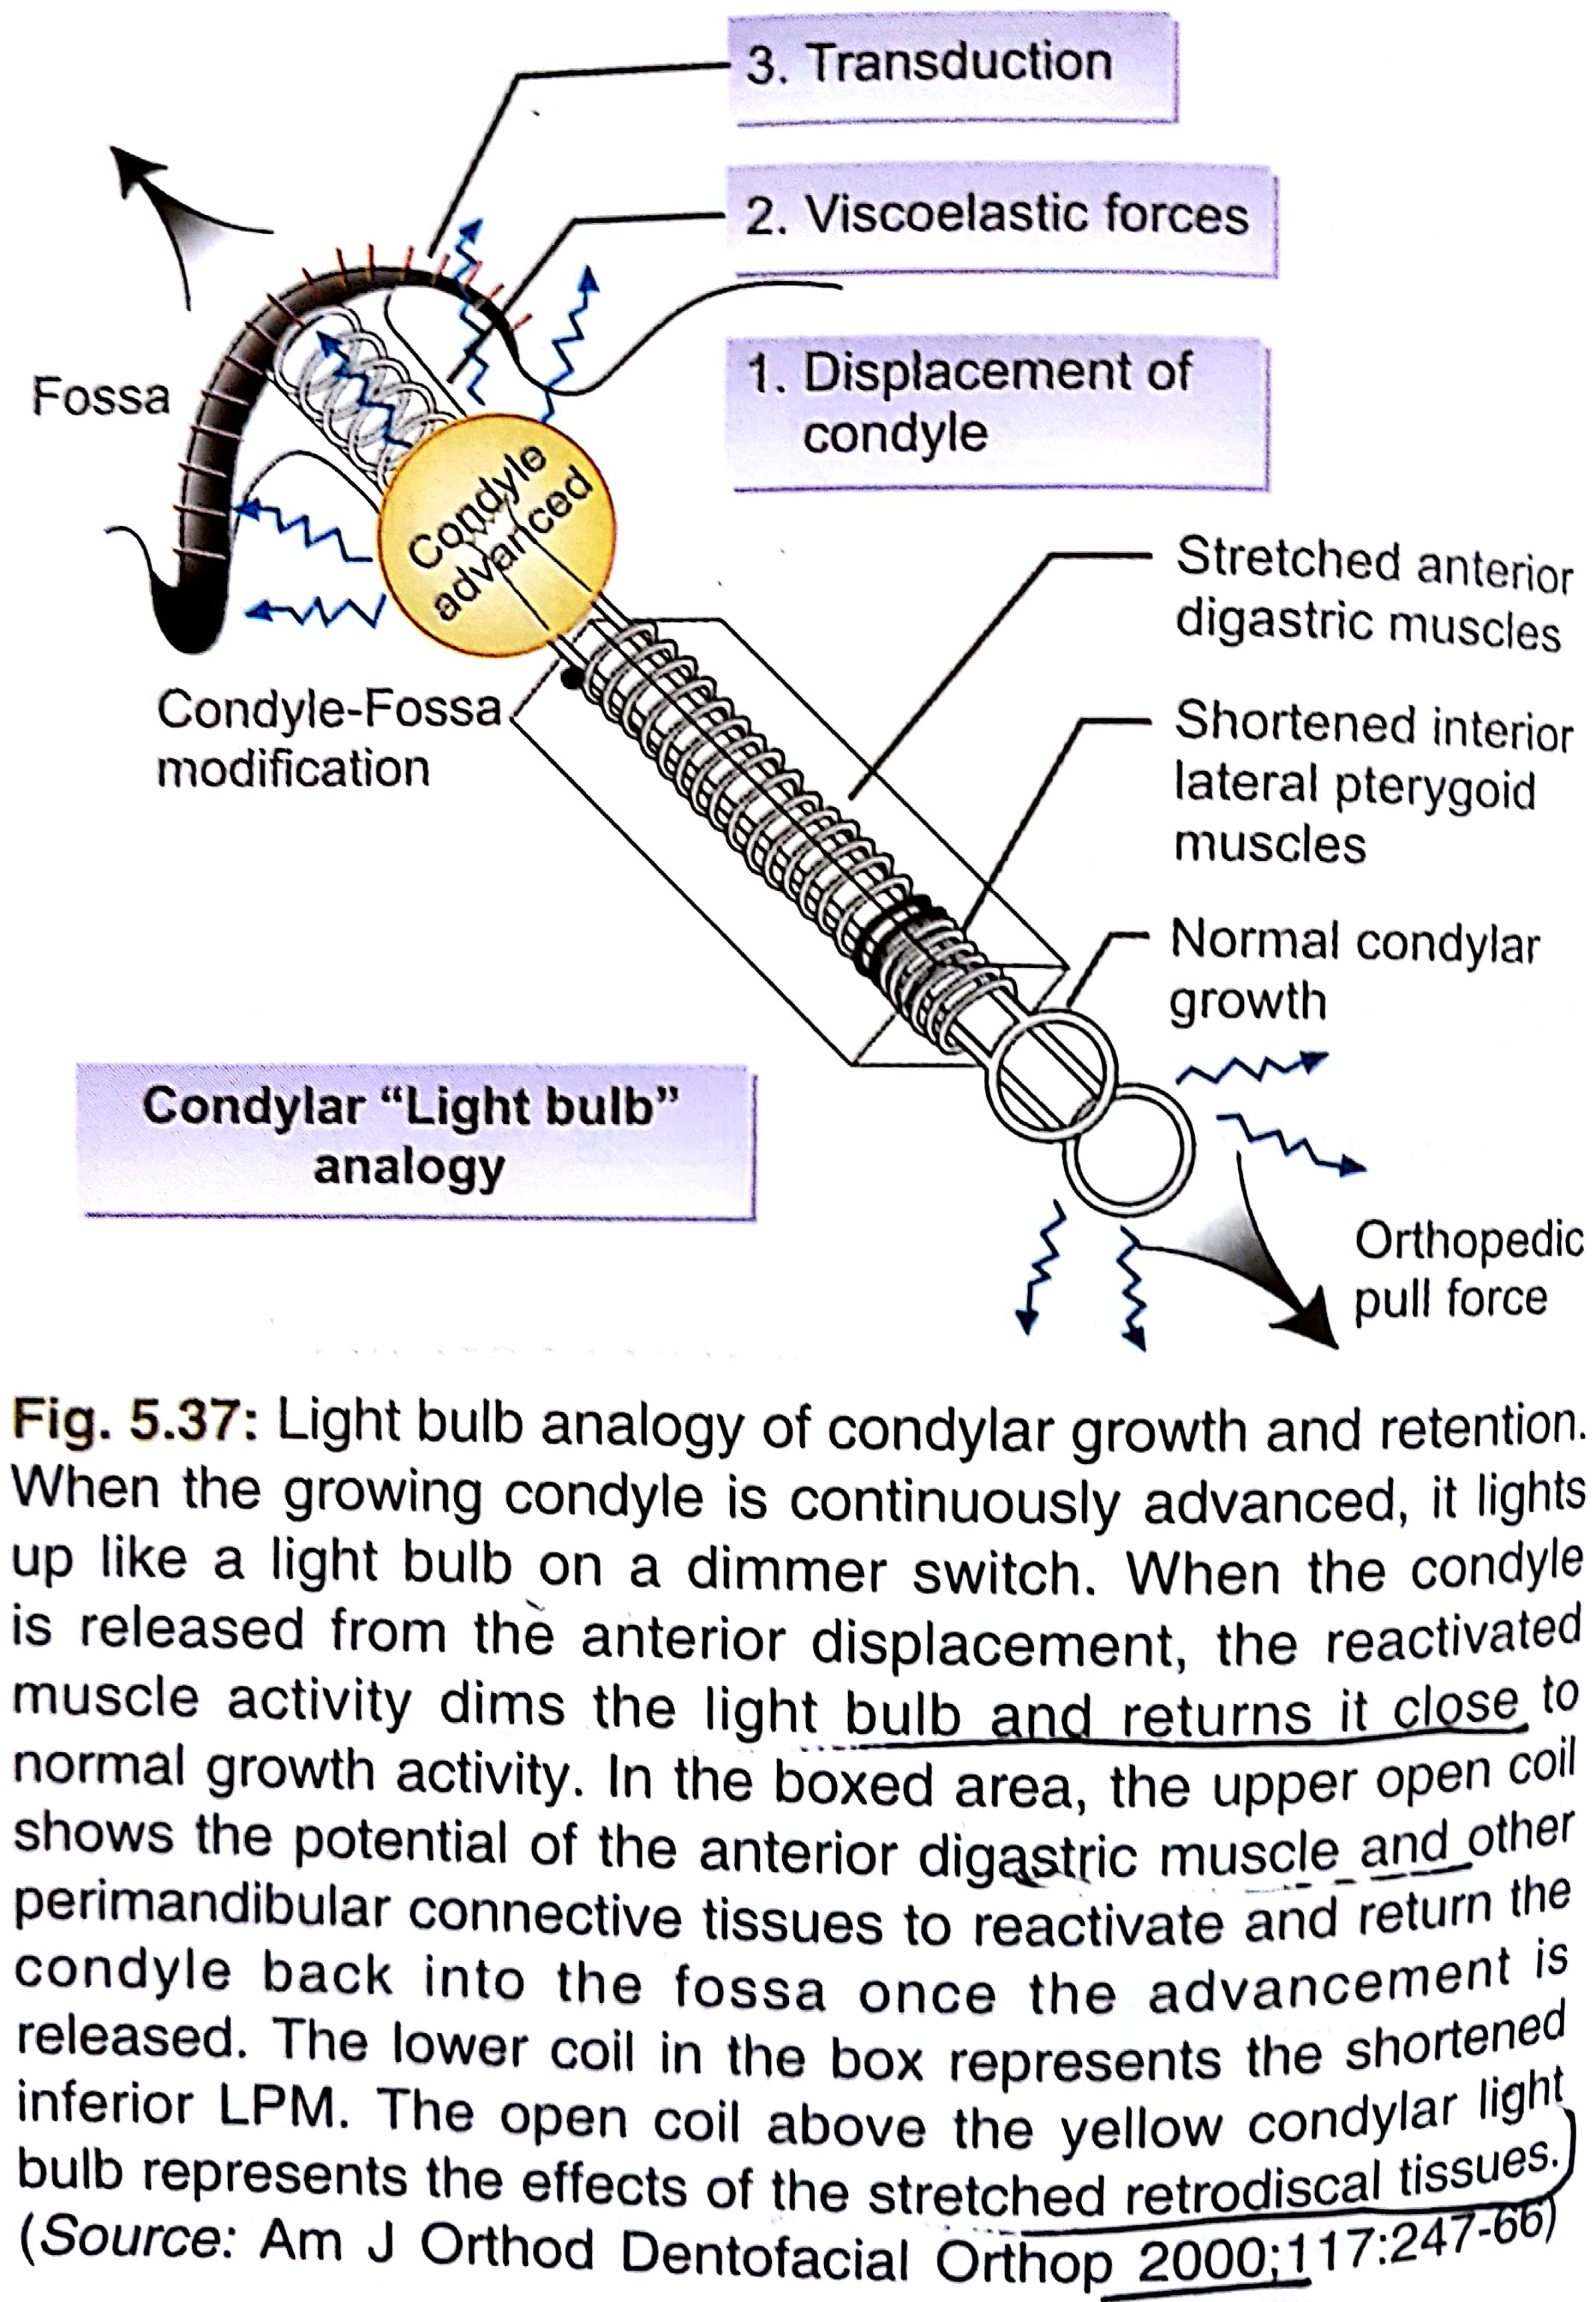
Voudouris and kuftinec compares this process with light bulb analogy.

Slide 35
Growth relativity is more specific to condyle only when compared to FMH.
Conclusion :
  Identifying the primary trigger mechanism for the growth of maxilla and mandible will help the orthodontist to either stimulate or retard the growth of the maxilla and mandible.
  This will be the key to successful growth modification treatment in skeletal malocclusion.

Slide 36
Conclusion For Theories Of Growth :
A good knowledge of growth and development helps us to know the etiology, diagnosis and treatment planning of malocclusion and also helps us to predict the prognosis of orthodontic treatment.
Growth modification by means of functional and orthodontic appliance gives better response before growth completion (best results during growth spurts).
Orthognathic surgery gives best results if done after completion of growth so as to prevent relapse.

Slide 37

SUMMARY
GROWTH :-
Major theories of growth
    Bone remodeling theory
    The genetic theory
    The sutural hypothesis
    Nasal septum theory
    Functional matrix hypothesis
    Von Limborgh’s compromise theory
    Modern composite theory
    Servo system theory/cybernetics in craniofacial growth
    Growth relativity hypothesis
    Functional matrix hypothesis revisited

Slide 38
REFERENCES
Textbook of Orthodontics – Gurkeerat Singh, Jaypee Brothers; 2nd Edition
Orthodontics – The Art and Science, S.I Bhalajhi, AryaMedi Publishing; 7th Edition
Textbook of Orthodontics – Sridhar Premkumar, Elsevier; 1st Edition
Orthodontics: Diagnosis and Management of Malocclusion and Dentofacial Deformities – O.P Kharbanda, Elsevier; 1st Edition

Slide 39
Question & Answer Session

